Slide 1
ACADEMIA EUROPAEA: PROSPECTS FOR A NORTHERN REGIONAL HUB
IN BERGEN
BERGEN, MAY 30, 2014

Slide 2
2 765 Active members
53 Countries
20 Sections

Slide 3
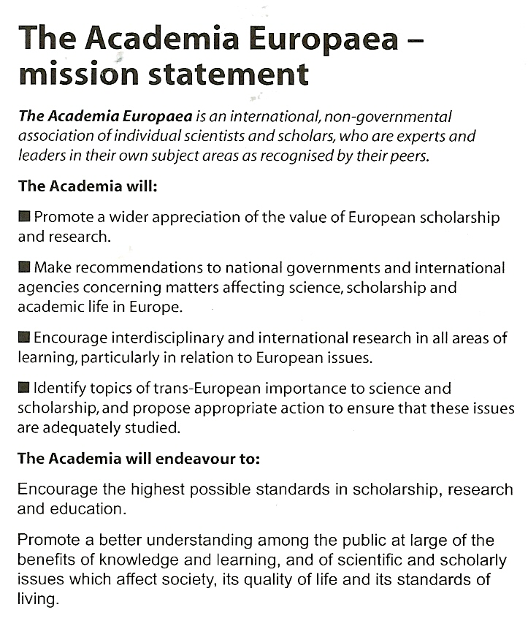

Slide 5
ACADEMIA EUROPAEA MEMBERS BY COUNTRY 2013

Slide 6
ACADEMIA EUROPAEA FIELDS/ SECTIONS 1988 and 2013

Slide 7
ACADEMIA EUROPAEA FIELDS/ SECTIONS 1988 and 2013

Slide 9
MY QUESTIONS : SUBSTANTIVE RESEARCH FOCI
How is the Nordic region defined ? How are “Northern Seas” delimited?
The Arctic World: opportunities for cross-cultural ands interdisciplinary networking
Policy analysis: reflections on previous programmes viewed from experience on the ground.
The role of humanities and social sciences : range and quality of Nordic expertise

Slide 10
AE MISSION/GOAL 1
Promote a wider appreciation of the value of European scholarship and research
RATIONALE FOR REGIONAL HUBS
Issues of scale : local, national, regional, global
Challenges of sustainable development
Diversity of political cultures
Tensions between central (EU-framework programmes) and regional traditions
Q: What is the areal extent of “Nordic” region and ”Northern Seas” ?

Slide 11
AE MISSION/GOAL 2
Identify topics of trans-European importance to science and scholarship and propose appropriate action to ensure that these issues are adequately studied
Sustainable development: ecological integrity, economic growth, social vitality
Migration and identity
Climate change
Technology and society
Q: The Arctic World: opportunities for cross-cultural and interdisciplinary networking ?

Slide 12


Slide 13
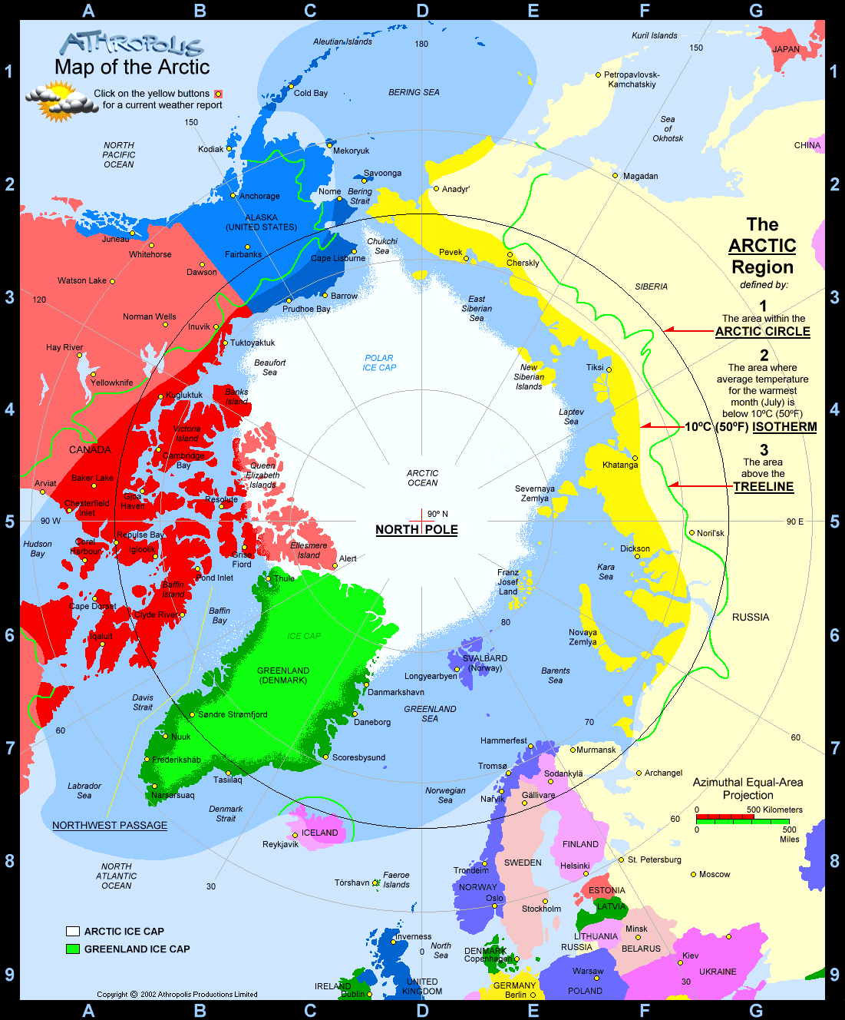

Slide 14
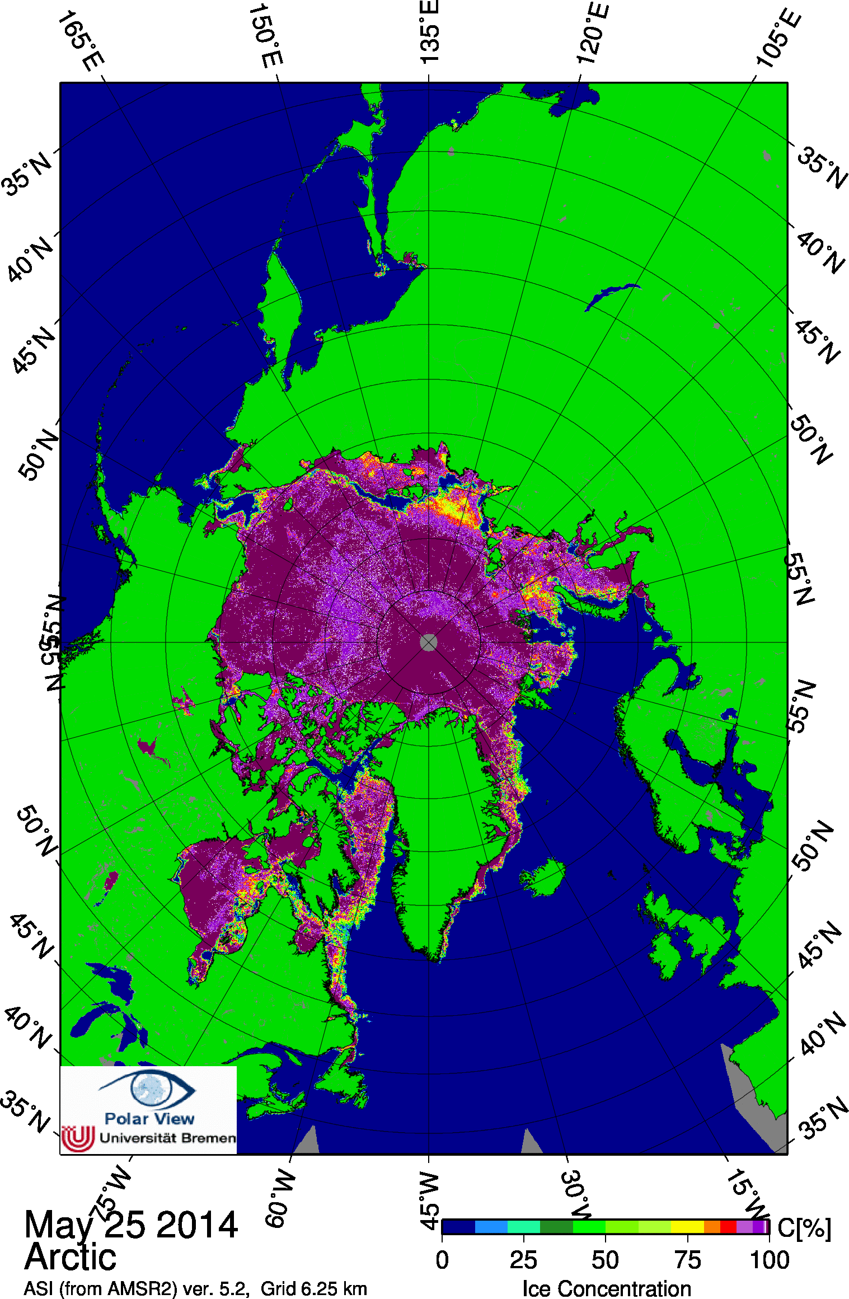

Slide 15
AE MISSION/GOAL 3
Make recommendations to national governments and international agencies concerning matters affecting science, scholarship and academic life in Europe
Policy analysis
Reflections on experience of various programmes/ processes on the ground
Relationships/dependencies on governments in educational curricula
Q: Plans for international collaboration/critical reflection on “Nordic” models ?

Slide 16


Slide 17
AE MISSION/GOAL 4
Encourage interdisciplinary and international research in all areas of learning, particularly in relation to European issues
Collaboration among AE “hubs” : Bergen – Barcelona - Wroclaw
Interactions between university and town
Doctoral training curricula
Q: The role of humanities and social sciences : range and access to Nordic expertise ?

Slide 18
ACADEMIA EUROPAEA FIELDS/ SECTIONS 1988 and 2013

Slide 22
2 765 Active members
53 Countries
20 Sections

