Slide 1
2024 Class A1 – Humanities Section – History & Archaeology
Overall section members: 319 Overall foreign members: 15 Overall female members: 72

Slide 2

2024 Class A1 – Humanities Section – History & Archaeology
Michael Alram Vienna Austria | Ancient and medieval numismatics Pre-Islamic monetary history of Iran, Central Asia and the Indo-Iranian borderlands

Slide 3
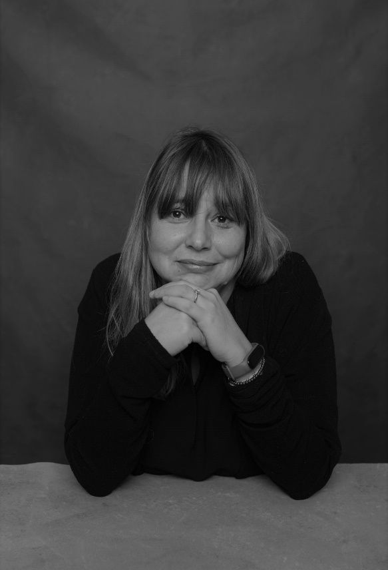
2024 Class A1 – Humanities Section – History & Archaeology
Marta Arzarello Ferrara Italy | First European peopling Prehistory Excavation methods Middle palaeolithic Firsts islands peopling Lower palaeolithic Lithic technology

Slide 4
2024 Class A1 – Humanities Section – History & Archaeology
Jennifer Anne Baird London United Kingdom | Cultural heritage Archaeological photography Ancient domestic architecture Roman provincial archaeology Roman Syria Ancient graffiti Archaeological archives

Slide 5
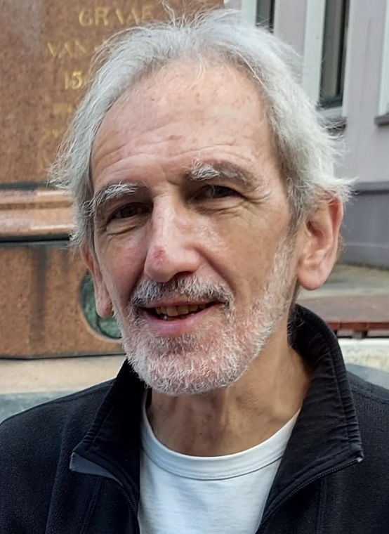
2024 Class A1 – Humanities Section – History & Archaeology
Antoon De Baets Groningen The Netherlands | Attacks on history History of history Abuses of history Censorship of history Theory of history History and human rights Ethics of historians

Slide 6

2024 Class A1 – Humanities Section – History & Archaeology
Ewa Domanska Poznań Poland | Methods of historical research Environmental humanities Ecocide and genocide studies Human remains as heritage Emerging fields in the humanities and social sciences Non-Western knowledges of the past and ways of knowing Theory and history of historiography Comparative theory of the humanities and social sciences

Slide 7
2024 Class A1 – Humanities Section – History & Archaeology
Peter Frankopan Cambridge United Kingdom | Belt and Road Initiative Silk Roads Studies Russia and the former Soviet Union Histories of China Central Asia Urbanization & nomadism Middle Eastern affairs Byzantine empire Climate change & the natural world

Slide 8
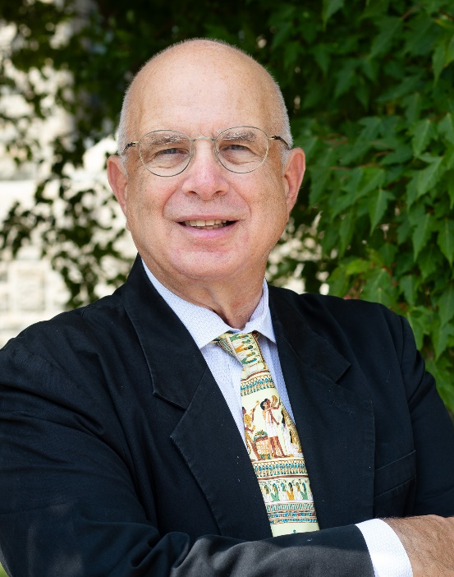
2024 Class A1 – Humanities Section – History & Archaeology
Haskel Greenfield Winnipeg Canada | Evolution of food producing and farming societies Evolution of metallurgical technology Evolution of early complex and urban societies Origins of pastoralism Origins of food production Old World archaeology Origins of metallurgy Zooarchaeology Archaeology of Europe, Near East and Africa Origins of animal domestication

Slide 9
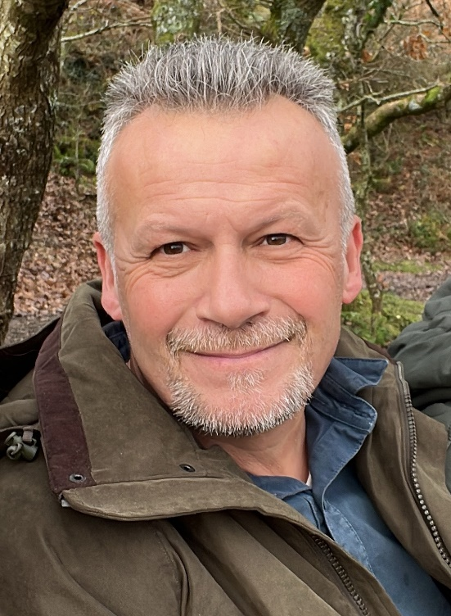
2024 Class A1 – Humanities Section – History & Archaeology
Timothy Insoll Exeter United Kingdom | African archaeology Islamic archaeology Archaeology of religion

Slide 10
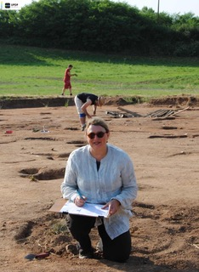
2024 Class A1 – Humanities Section – History & Archaeology
Sophie Krausz Paris France | Large-scale field archaeological projects Fortifications Continental Europe Emergence of the state Political systems Iron Age, Prehistory Celts Urbanisation Archaeological concomitants of peace and war Protohistoric and later Mediterranean civilisations

Slide 11
2024 Class A1 – Humanities Section – History & Archaeology
Tijana Krstic Vienna Austria | Religious conversion Comparative study of empires in early modern Eurasia Cultural, religious, and intellectual history of the early modern Ottoman Empire Islamic intellectual history Early modern Mediterranean history

Slide 12
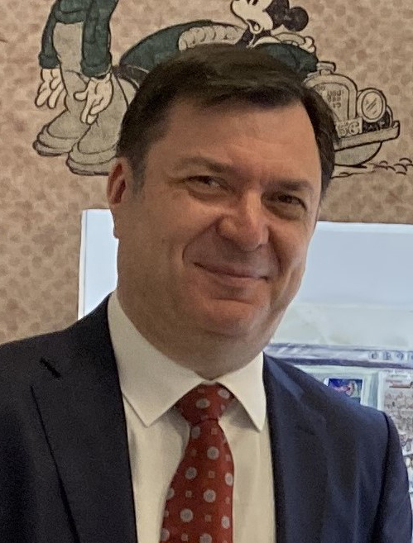
2024 Class A1 – Humanities Section – History & Archaeology
Slobodan Markovich Belgrade Serbia | History of European pessimism Psychoanalytic anthropology Western perceptions of the Balkans Cultural transfer Europe – the Balkans History of psychoanalysis British-Balkan relations since the Napoleonic Wars

Slide 13
2024 Class A1 – Humanities Section – History & Archaeology
Matthias Middell Leipzig Germany | Global studies History Political geography

Slide 14
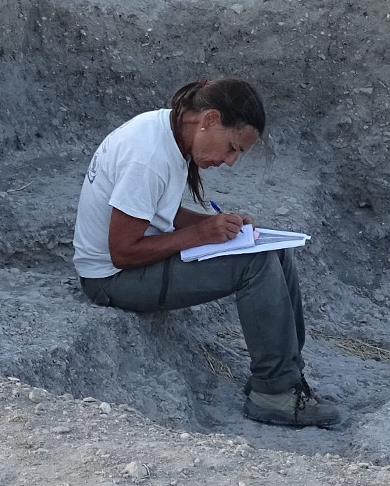
2024 Class A1 – Humanities Section – History & Archaeology
Luisa Migliorati Rome Italy | Heritage buildings Mexico colonial urbanism Ancient topography Ancient cartography Ancient urbanism Ancient architecture

Slide 15
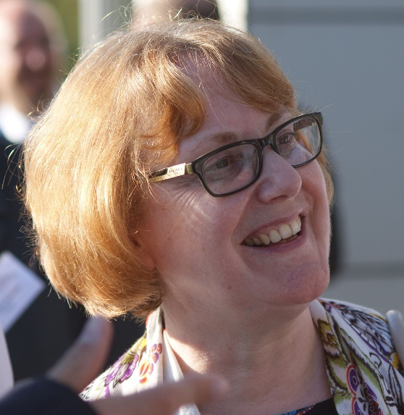
2024 Class A1 – Humanities Section – History & Archaeology
Felicitas Schmieder Hagen Germany | Europe and the Mongols in the Middle Ages Medieval Europe Medieval cultural contacts Medieval prophecy Medieval German urban history Medieval/ early modern cartography

Slide 16
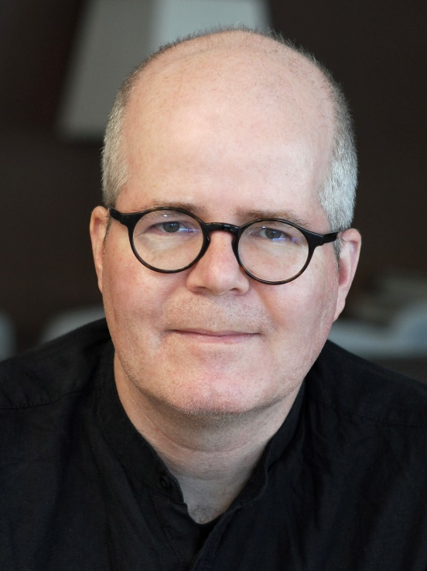
2024 Class A1 – Humanities Section – History & Archaeology
Daniel Siemens Newcastle United Kingdom | Political history History of religion History of violence Politics of the past Intellectual history History of law History of reparations National Socialism

Slide 17
2024 Class A1 – Humanities Section – History & Archaeology
Matthew Spriggs Canberra Australia | Cornish language history and Cornish studies Subsistence systems and human-environment interactions History of archaeology Archaeological theory Pacific and Southeast Asian archaeology Archaeology, linguistics and genetics

Slide 18
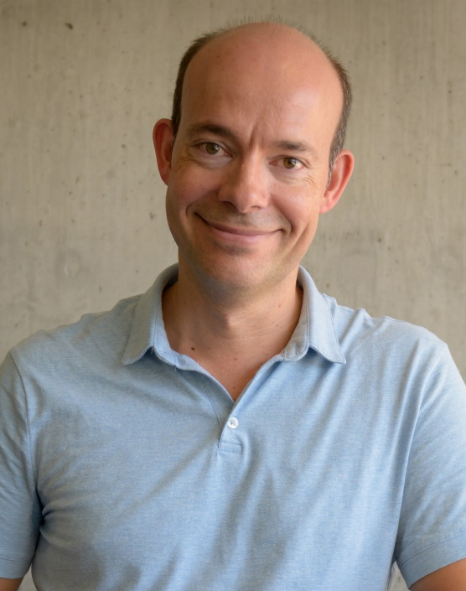
2024 Class A1 – Humanities Section – History & Archaeology
Philipp Stockhammer Munich Germany | Bioarchaeology Prehistory Mediterranean Ancient DNA Near East Archaeology Europe

Slide 19
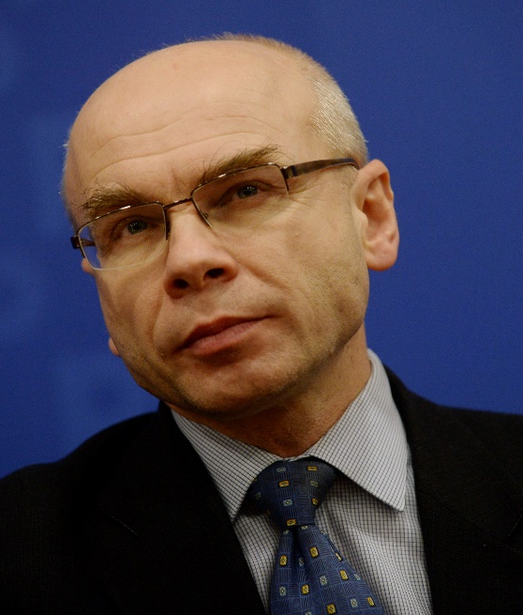
2024 Class A1 – Humanities Section – History & Archaeology
Dariusz Stola Warsaw Poland | History of transnational migrations Contemporary history of Poland History of Polish-Jewish relations Holocaust History of communist regimes

Slide 20
2024 Class A1 – Humanities Section – Classics & Oriental Studies
Overall section members: 171 Overall foreign members: 9 Overall female members: 45

Slide 21
2024 Class A1 – Humanities Section – Classics & Oriental Studies
Jens Braarvig Oslo Norway | History and languages of Buddhism Paleography History of religion/culture Textual criticism Sanskrit, Tibetan, Chinese History of knowledge Multilingualism in history Comparative philology

Slide 22
2024 Class A1 – Humanities Section – Classics & Oriental Studies
Monica Centanni Venice Italy | Iconology and history of art Ancient theatre Classical Tradition Aby Warburg and Mnemosyne Atlas Renaissance studies Transition from Paganism to Christianity, from the Middle Ages to the Renaissance Culture of Late Antiquity (Hellenistic novel)

Slide 23
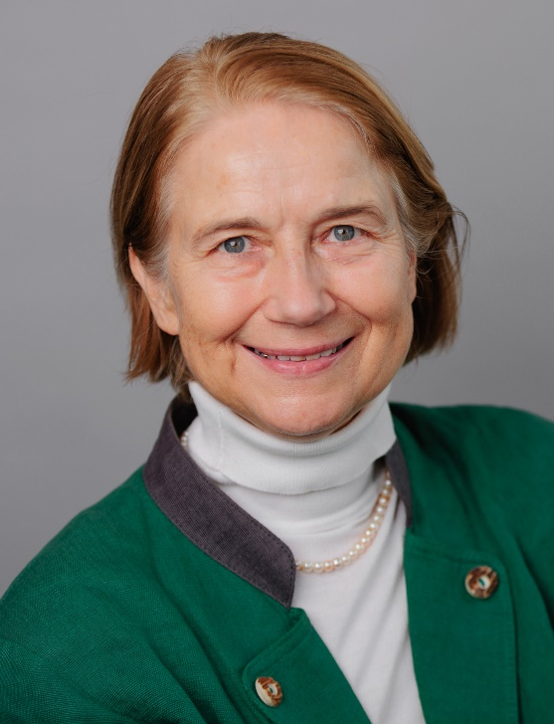
2024 Class A1 – Humanities Section – Classics & Oriental Studies
Almut Hintze London United Kingdom | Multimedia and virtual reality documentation of Avestan rituals Electronic corpora and manuscript analysis Ritual studies and theory Sustainable long-term and standards-based hosting and preservation of digital data Multimedia language documentation Minority cultures and religions and languages in Iran and India, especially Zoroastrianism Sasanian seals and Middle Persian epigraphy Historical and comparative philology and linguistics of ancient Indo-Iranian languages

Slide 24
2024 Class A1 – Humanities Section – Classics & Oriental Studies
Arlene Holmes Henderson Durham United Kingdom | Public policy Social mobility Classics education Languages in education Public engagement Employability Rhetoric Critical skills Humanities in education

Slide 25
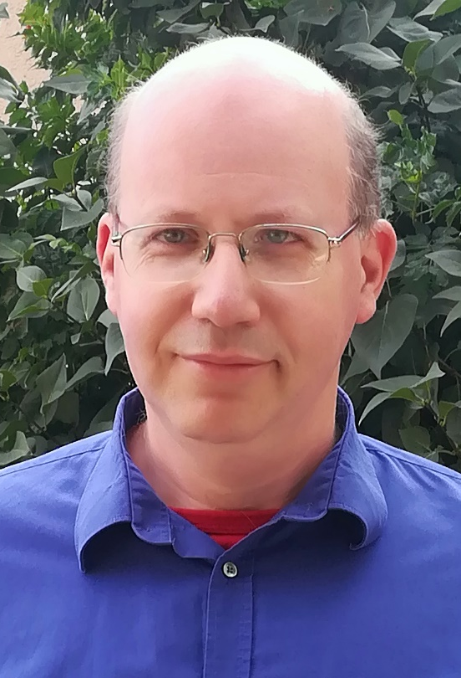
2024 Class A1 – Humanities Section – Classics & Oriental Studies
Gábor Kósa Budapest Hungary | Manichaeism Cosmogonic myths Shamanism Chinese religions

Slide 26

2024 Class A1 – Humanities Section – Classics & Oriental Studies
Enrico Morano Turin Italy | Manichaeism Middle Iranian languages Iranian epigraphy Old Iranian languages Classics

Slide 27
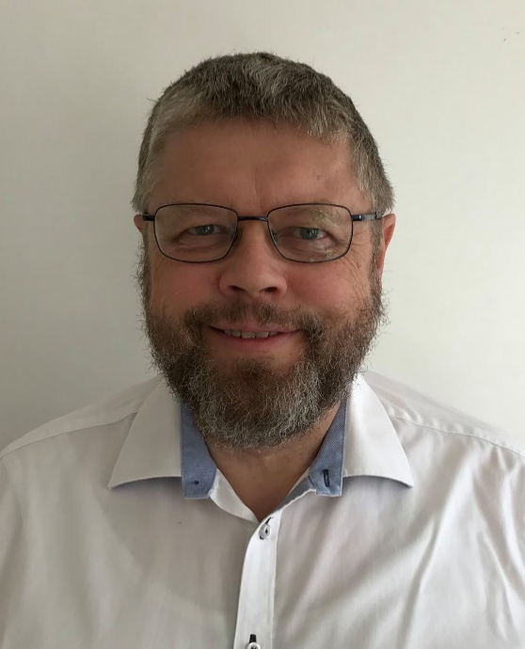
2024 Class A1 – Humanities Section – Classics & Oriental Studies
Nils Arne Pedersen Aarhus Denmark | Patristics Christian Orient Manichaeism Church history Reception of Bible

Slide 28
2024 Class A1 – Humanities Section – Classics & Oriental Studies
Federico Santangelo Newcastle United Kingdom | History of ancient historiography History of classical scholarship Roman history Hellenistic history History of ancient Italy

Slide 29
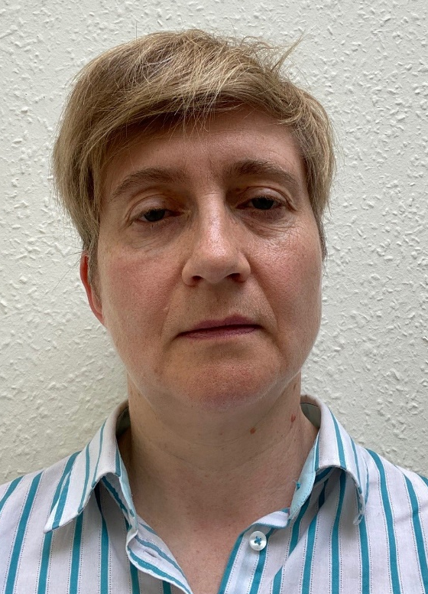
2024 Class A1 – Humanities Section – Classics & Oriental Studies
Catherine Steel Glasgow United Kingdom | Cicero Roman oratory Late Roman Republican history

Slide 30
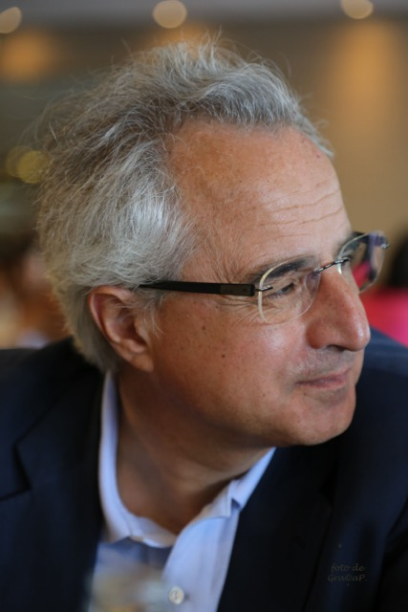
2024 Class A1 – Humanities Section – Classics & Oriental Studies
Mauro Tulli Pisa Italy | Platonic studies Greek Epic poetry Ancient rhetoric Papyrology Hellenistic philosophy

Slide 31
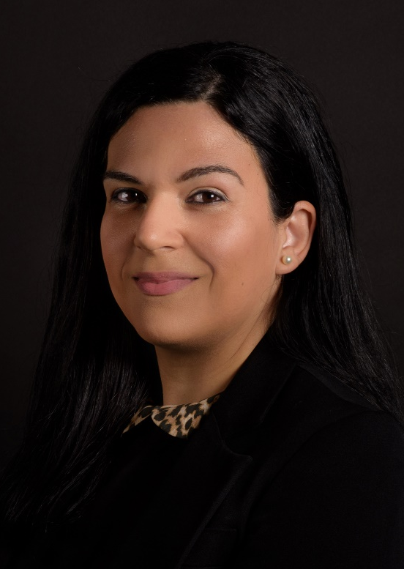
2024 Class A1 – Humanities Section – Classics & Oriental Studies
Sophia Xenophontos Kefalonia Greece | Reception of the classical tradition in Byzantium and the Modern Greek Enlightenment Greek literature of the 1st and 2nd century CE Plutarch: biography, popular philosophy, moralising techniques History of medical deontology in antiquity Intellectual history and history of ideas in antiquity and the medieval period History of emotions and psychotherapy Commentary tradition especially on Aristotle’s works Edition, textual criticism and translation of ancient and Byzantine texts Galen: interplay between medicine and practical philosophy, the social role of philosophy

Slide 32
2024 Class A1 – Humanities Section – Linguistic Studies
Overall section members: 235 Overall foreign members: 8 Overall female members: 15

Slide 33
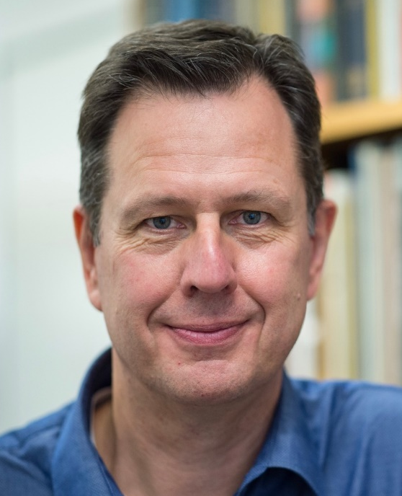
2024 Class A1 – Humanities Section – Linguistic Studies
Bas Aarts London United Kingdom | Corpus linguistics Syntax Linguistic usage Language change English grammar Language teaching and pedagogy

Slide 34
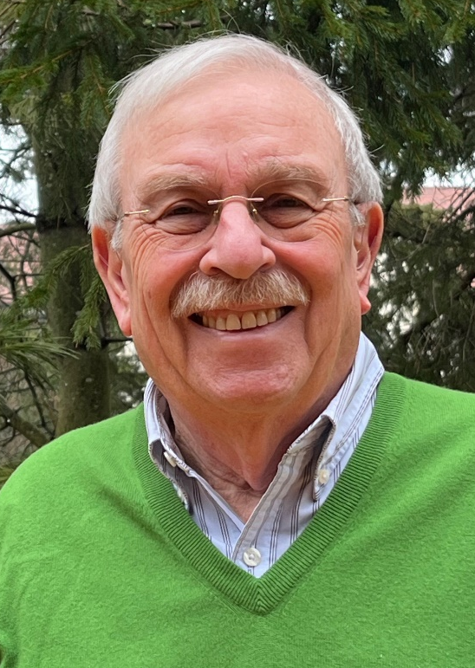
2024 Class A1 – Humanities Section – Linguistic Studies
Mark Aronoff Stony Brook USA | Linguistic morphology Sign language Writing systems Teaching linguistics

Slide 35
2024 Class A1 – Humanities Section – Linguistic Studies
Matthew Baerman Guildford United Kingdom | Historical linguistics Linguistic typology Linguistic morphology

Slide 36
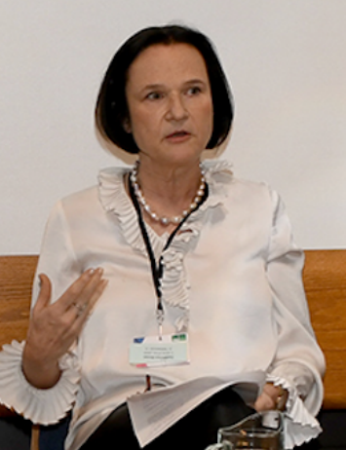
2024 Class A1 – Humanities Section – Linguistic Studies
Anna Carlier Paris France | Theories of linguistic change Nominal determination Historical linguistics of French Corpus linguistics Comparative linguistics of the Romance languages Aspect, voice, and auxiliaries Morphosyntax Grammatical semantics

Slide 37
2024 Class A1 – Humanities Section – Linguistic Studies
Ewa Dąbrowska Erlangen Germany | Language aptitude Cognitive linguistics Artificial language learning Language and cognition Usage based approaches Individual differences in linguistic knowledge Language processing Language acquisition

Slide 38
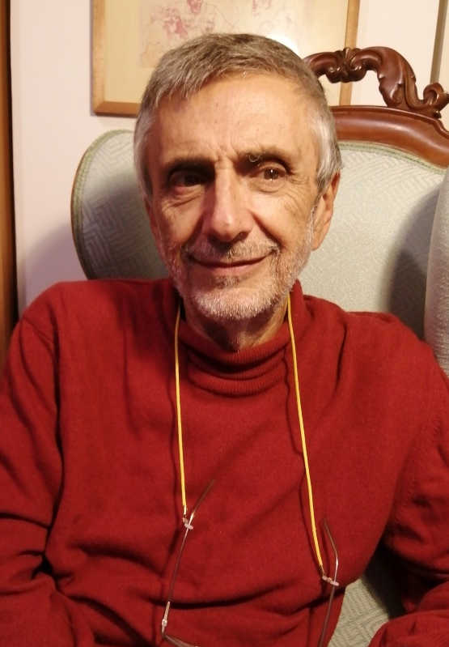
2024 Class A1 – Humanities Section – Linguistic Studies
Franco Fanciullo Pisa Italy | Languages in contact in the Mediterranean Sea during the Middle Ages Italian and dialectal etymology Italian and Greek linguistics Italian dialectology Historical linguistics

Slide 39
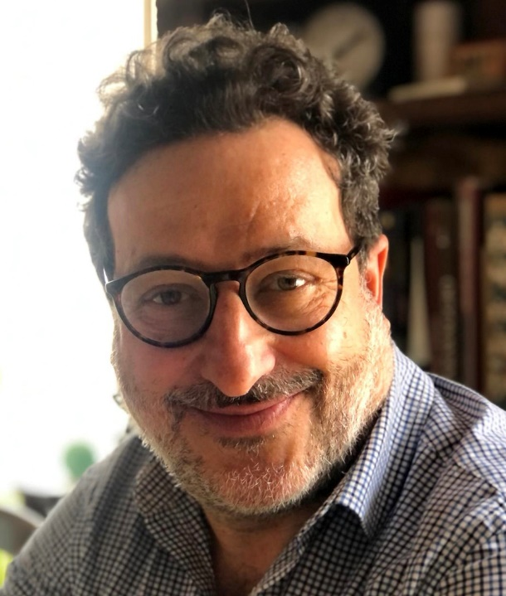
2024 Class A1 – Humanities Section – Linguistic Studies
Livio Gaeta Turin Italy | Contrastive linguistics Linguistic minorities German and Germanic linguistics Theoretical linguistics: morphology and word-formation Language contact Language change and grammaticalization Cognitive linguistics Italian and Romance linguistics

Slide 40
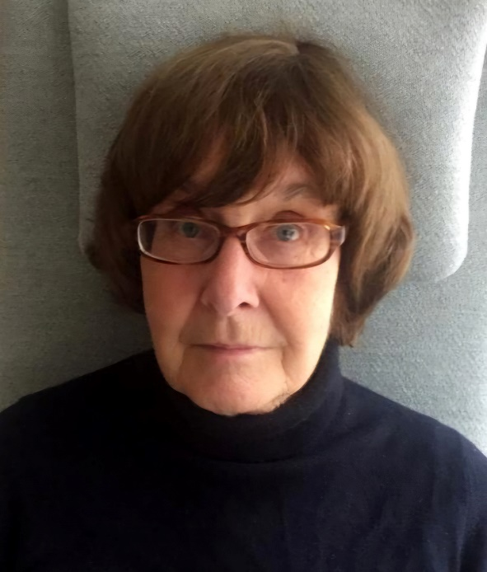
2024 Class A1 – Humanities Section – Linguistic Studies
Juliane House Hamburg Germany | Applied linguistics English as a Lingua Franca Translation theory and criticism Discourse analysis Second language acquisition Cross-cultural pragmatics Politeness

Slide 41
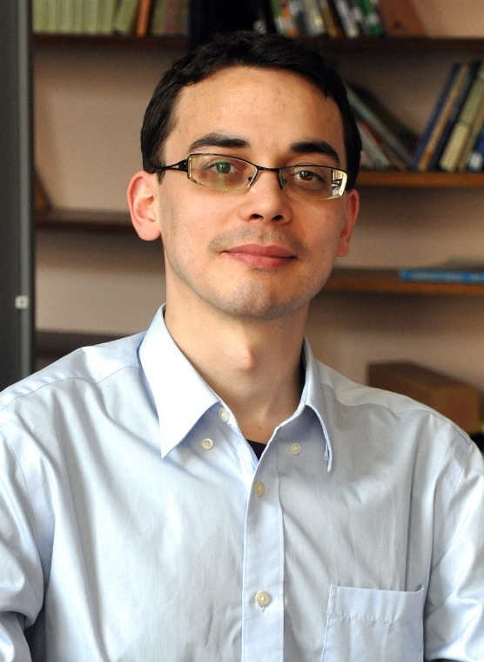
2024 Class A1 – Humanities Section – Linguistic Studies
Guillaume Jacques Paris France | Archaeolinguistics Linguistic typology Historical linguistics (Sino-Tibetan, Indo-European, Algonquian) Language documentation (Rgyalrongic, Kiranti)

Slide 42
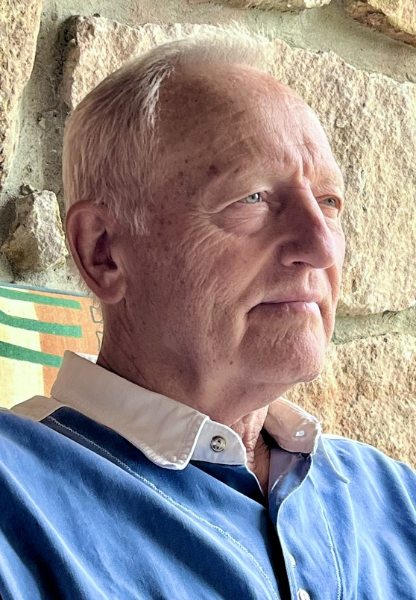
2024 Class A1 – Humanities Section – Linguistic Studies
Zoltán Kövecses Budapest Hungary | Universality and variation in metaphor Language of emotions American English Theory of metaphor and metonymy Lexicography

Slide 43
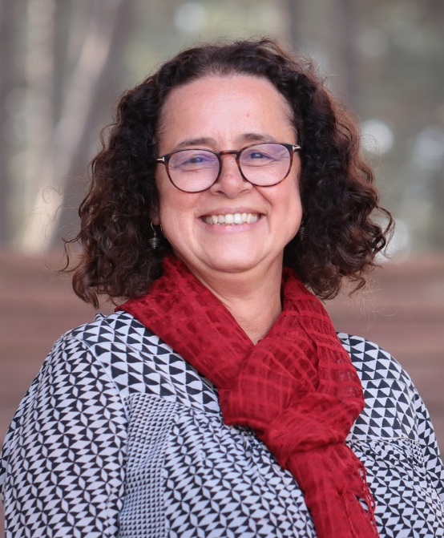
2024 Class A1 – Humanities Section – Linguistic Studies
Aylin Küntay Istanbul Turkey | Communicative development Gestures Bilingualism and heritage languages Social robots in educational use Psycholinguistics Child language development

Slide 44
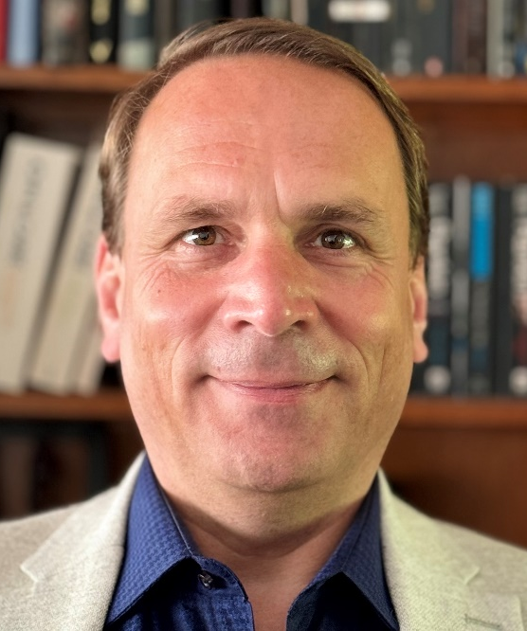
2024 Class A1 – Humanities Section – Linguistic Studies
Lutz Marten London United Kingdom | Area studies Bantu languages African languages Comparative and historical linguistics Swahili Linguistics

Slide 45
2024 Class A1 – Humanities Section – Linguistic Studies
Eugen Munteanu Iassy Romania | General linguistics and theory of language Language contacts and traductology History of linguistic ideas Biblical studies Philosophy of language Romanian philology Semantics Lexicography Classical philology

Slide 46
2024 Class A1 – Humanities Section – Linguistic Studies
Janet Pierrehumbert Oxford United Kingdom | Speech technology Phonology Language processing Morphology Sound change Computational linguistics Language modeling

Slide 47
2024 Class A1 – Humanities Section – Linguistic Studies
Gábor Prószéky Budapest Hungary | Computational lexicography Computational morphology Terminology Large language models Machine translation

Slide 48
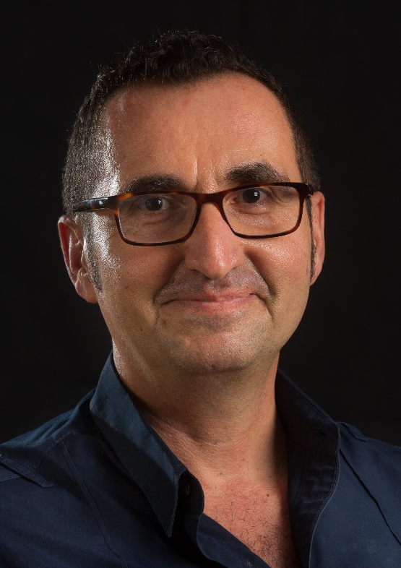
2024 Class A1 – Humanities Section – Linguistic Studies
Josep Quer Barcelona Spain | Greek Syntax Semantics Sign languages Romance languages

Slide 49
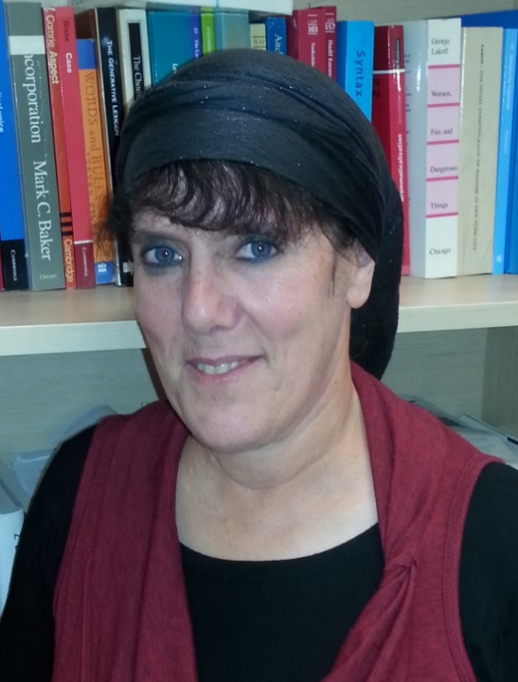
2024 Class A1 – Humanities Section – Linguistic Studies
Malka Rappaport Hovav Jerusalem Israel | Polysemy Argument structure Syntax Event semantics Lexical semantics Lexical and grammatical aspect Semantics-cognition interface Morphology

Slide 50
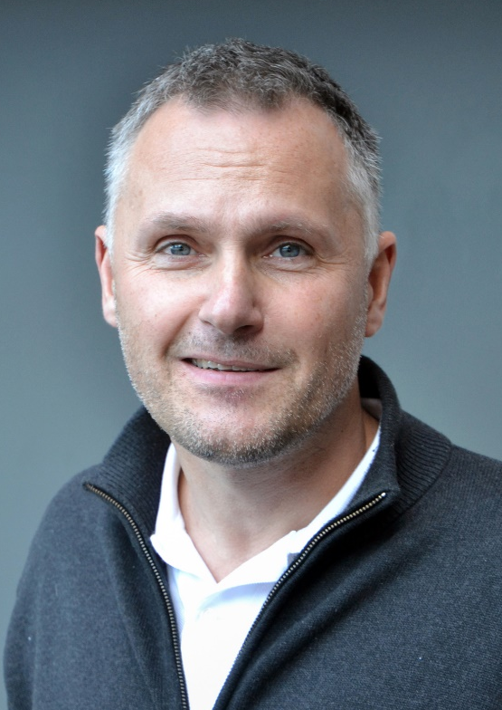
2024 Class A1 – Humanities Section – Linguistic Studies
Michael Schulte Kristiansand Norway | Comparative linguistics Writing system research (Runes) Formulaic language (Runic inscriptions) Runic inscriptions (Runology) Language history (Nordic) Metrical studies of Old Germanic Sociocultural history (Nordic) Proto-Norse Germanic philology Old Norse

Slide 51
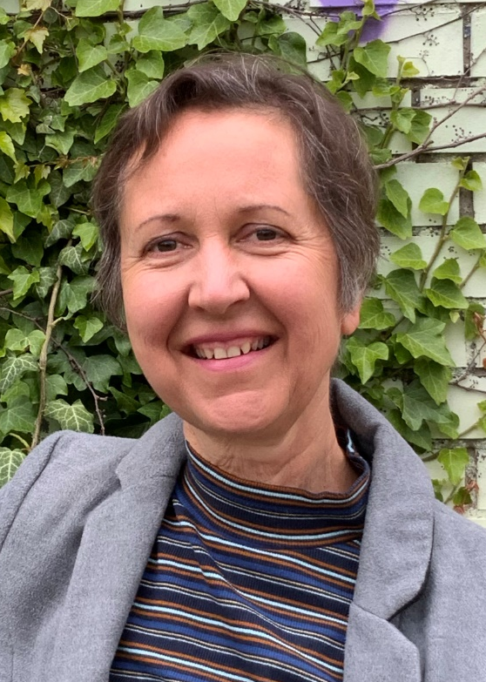
2024 Class A1 – Humanities Section – Linguistic Studies
Heike Wiese Berlin Germany | Grammar and lexicon Linguistic architecture Linguistic variation and contact Language attitudes and ideologies

Slide 52
2024 Class A1 – Humanities Section – Literary & Theatrical Studies
Overall section members: 230 Overall foreign members: 22 Overall female members: 80

Slide 53
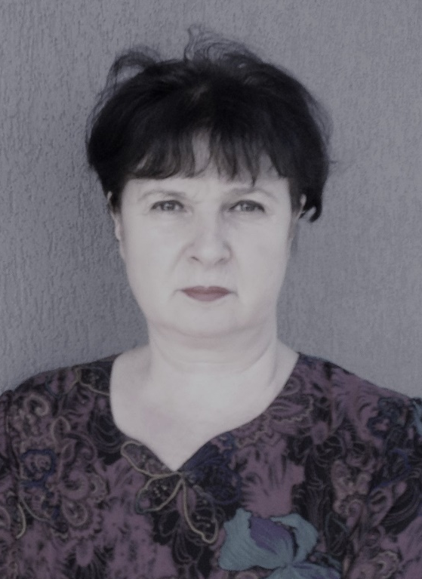
2024 Class A1 – Humanities Section – Literary & Theatrical Studies
Ruxandra Cesereanu Cluj-Napoca Romania | World literature Imagination studies Film studies Comparative literature Political and historical studies - Gulag and Holocaust Mentality studies

Slide 54
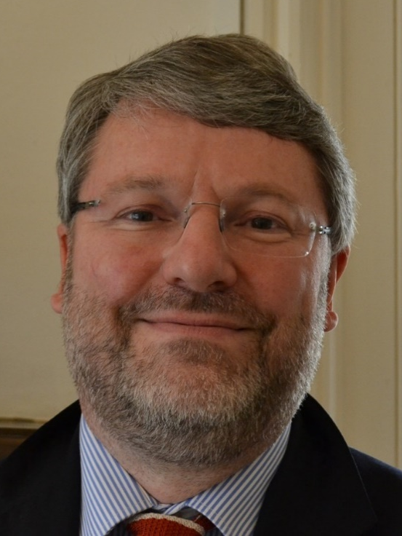
2024 Class A1 – Humanities Section – Literary & Theatrical Studies
Nicholas Cronk Oxford United Kingdom | Enlightenment thought Voltaire 18th-century history of the book Digital Humanities 18th-century French literature 18th-century correspondence

Slide 55

2024 Class A1 – Humanities Section – Literary & Theatrical Studies
Helena Duffy Wrocław Poland | Postmodernism Holocaust literature and cinema French and comparative literature Posthumanism (ecocriticism and human-animal studies)

Slide 56
2024 Class A1 – Humanities Section – Literary & Theatrical Studies
Frode Helland Trondheim Norway | Ibsen-studies Racism Holocaust-studies Literature Rhetoric

Slide 57
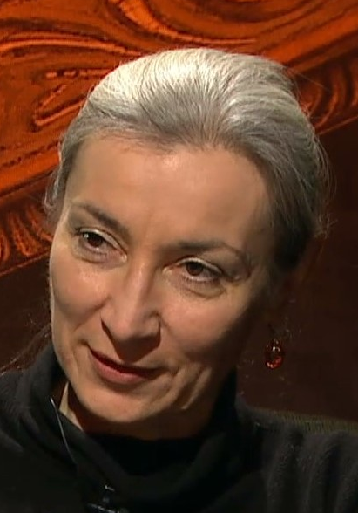
2024 Class A1 – Humanities Section – Literary & Theatrical Studies
Tatjana Jukić Zagreb Croatia | English literature (19th and 20th centuries) Semiotics Comparative literature Film and visual arts European cultural history Social philosophy

Slide 58
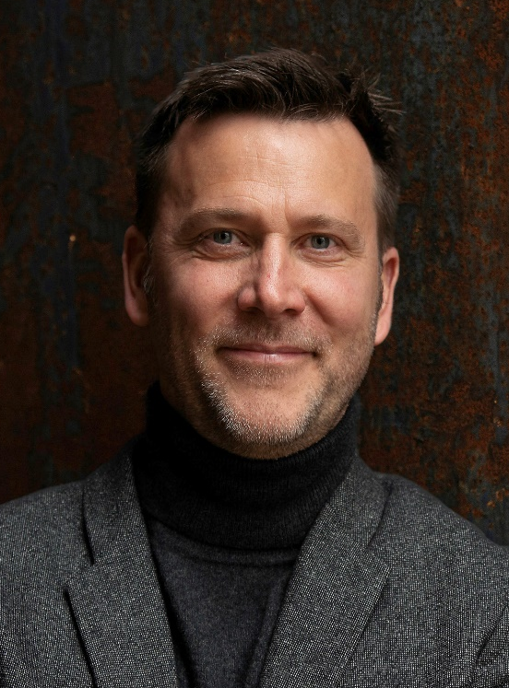
2024 Class A1 – Humanities Section – Literary & Theatrical Studies
Markus Messling Saarbrücken Germany | Comparative literature and cultural philosophy French and Francophone literatures Epistemology and history of the modern humanities Historical anthropology Narration and historiography Aesthetics Mediterranianism Universalism/relativism The irreparable and theories of reparation/repair

Slide 59
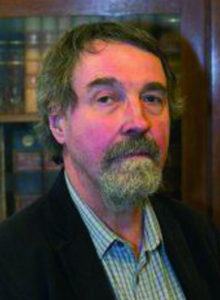
2024 Class A1 – Humanities Section – Literary & Theatrical Studies
Martin Procházka Prague Czech Republic | Intercultural communication American colonial literature Comparative literature Scottish literature Romanticism

Slide 60
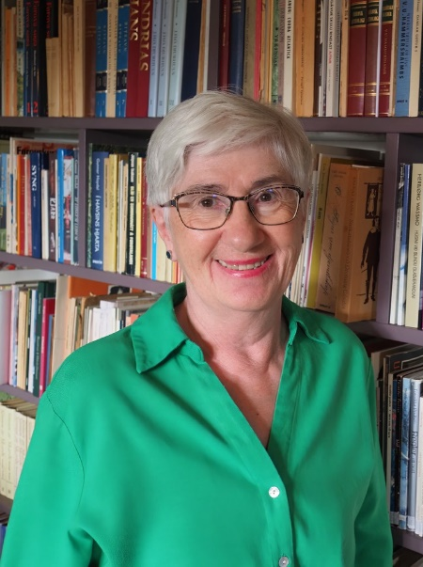
2024 Class A1 – Humanities Section – Literary & Theatrical Studies
Turið Sigurðardóttir Torshavn Faroe Islands | Icelandic literature Translation Faroese literature

Slide 61
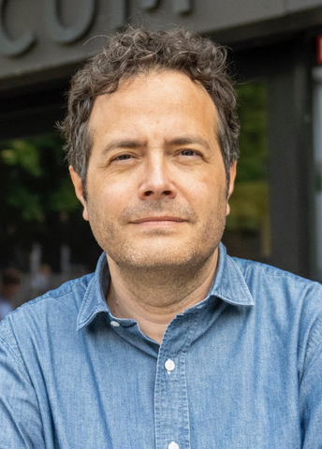
2024 Class A1 – Humanities Section – Literary & Theatrical Studies
Carlos Spoerhase Munich Germany | Sociology of literature in the global literary field Literary theory and general criticism Relationship between aesthetics and social theory History of the humanities Modern German and European literary history Modern German and European intellectual history Methods and practices of philological research

Slide 62
2024 Class A1 – Humanities Section – Literary & Theatrical Studies
Anne Tomiche Paris France | Experiments in art in the 20th century Gender studies Comparative literature Modernisms, modernities, avant-gardes Philosophy (deconstruction) and literature

Slide 63
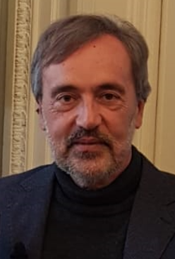
2024 Class A1 – Humanities Section – Literary & Theatrical Studies
Carlo Vecce Naples Italy | Renaissance literature and civilization Italian literature from Middle Age to Modernity History of books and libraries Transmission of texts in Middle Ages and Renaissance Intercultural exchanges Intermediality (Literature, Visual Arts, Cinema, Music) Classical and humanist philology Intellectual workshops in Modern Age

Slide 64

2024 Class A1 – Humanities Section – Literary & Theatrical Studies
Eva von Contzen Freiburg Germany | Narratology Hagiography History of reception Re-telling Medieval English studies

Slide 65
2024 Class A1 – Humanities Section – Musicology & Art History
Overall section members: 152 Overall foreign members: 9 Overall female members: 38

Slide 66
2024 Class A1 – Humanities Section – Musicology & Art History
Barbara Arciszewska Warsaw Poland | Court studies Early modern history Architectural theory Architectural history Art theory Gender studies Art history

Slide 67
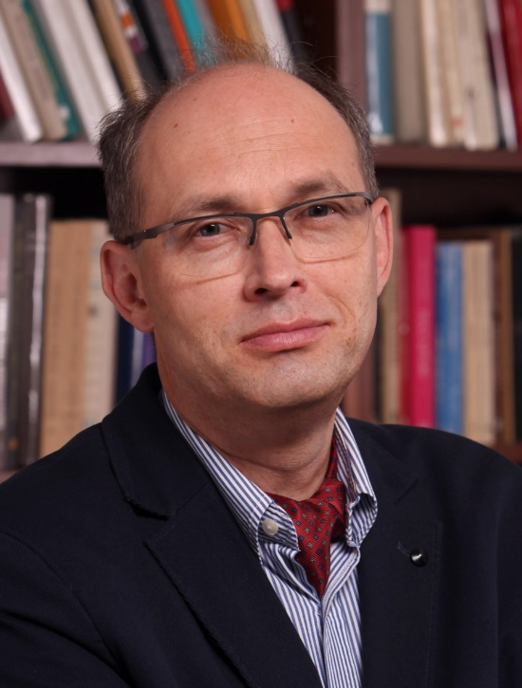
2024 Class A1 – Humanities Section – Musicology & Art History
Wojciech Bałus Kraków Poland | History of modern art and architecture History of art theory Methodology of art history and Bildwissenschaft Theory and history of stained-glass

Slide 68
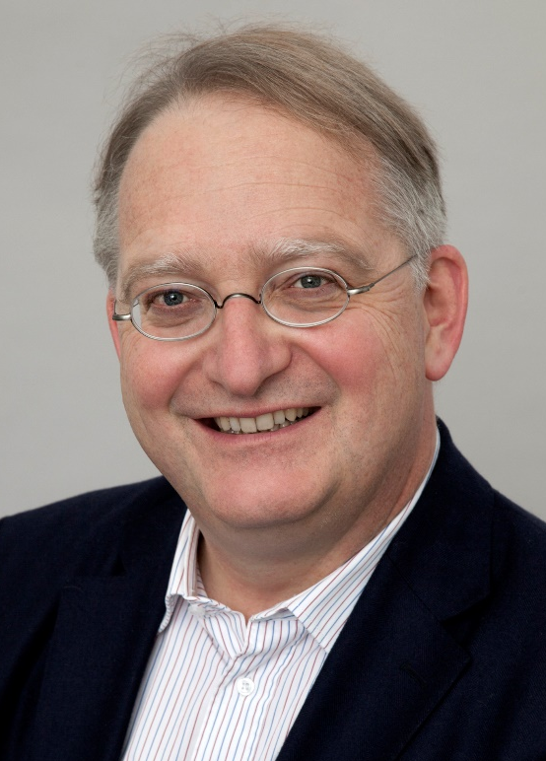
2024 Class A1 – Humanities Section – Musicology & Art History
Gerd Blum Münster Germany | Non-figurative Modernist Art and its reception since 1980 Beginnings of Modernist Painting (Marées; Manet) Views and Site-Specificity in Early Modern Architecture Early modern theory of architecture Reception history of the Tabernacle Narrative of Schemot Early modern historiography of art Exodus in Early Modern Art and texts on Art (Ark of the Covenant; Bezalel; Moses) How form becomes formula and stereotype, from 1500 to present

Slide 69
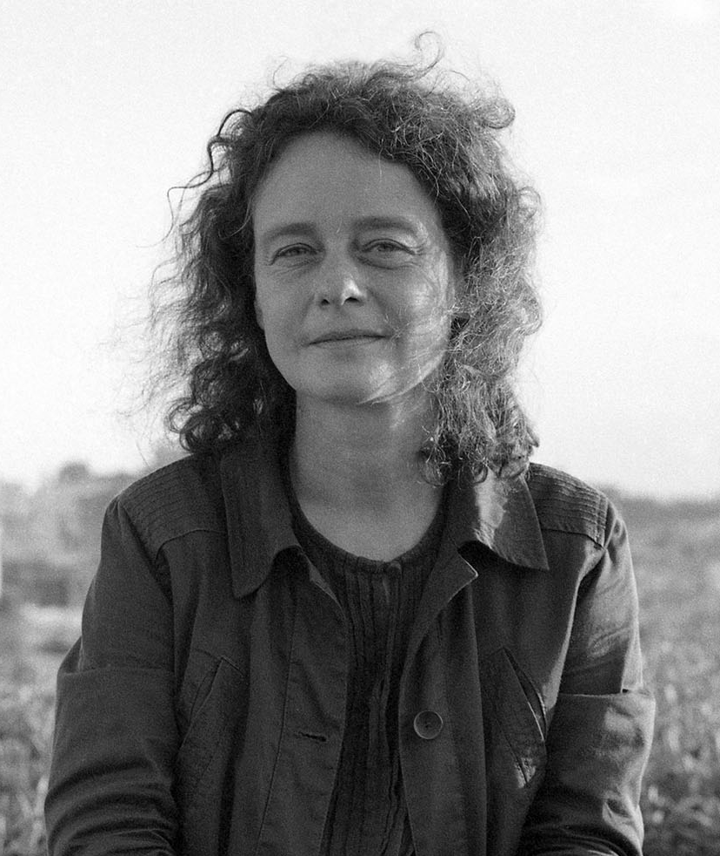
2024 Class A1 – Humanities Section – Musicology & Art History
Diane Bodart New York USA | Image theory and artistic practice in Renaissance and Baroque Italy Art History Renaissance Venice Art and Politics in the Spanish Habsburg Empire

Slide 70
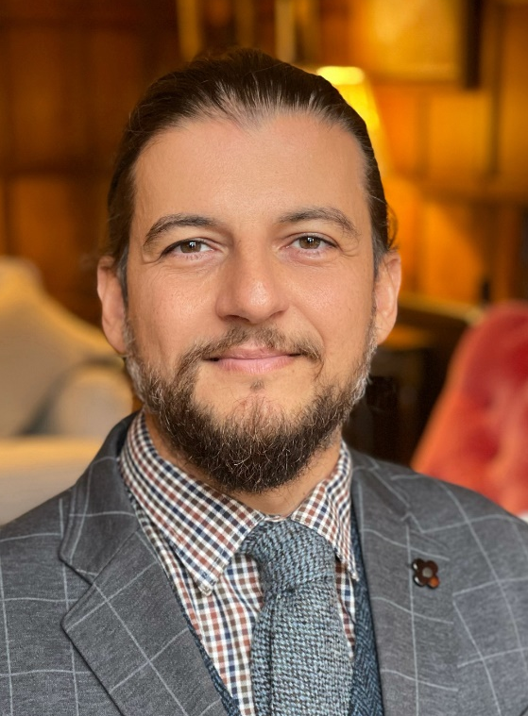
2024 Class A1 – Humanities Section – Musicology & Art History
Massimo Leone Turin Italy | Theoretical frameworks for modeling cultural change in semiotic terms Art history Digital evolution of visual cultures

Slide 71
2024 Class A1 – Humanities Section – Musicology & Art History
Emilio Sala Milan Italy | Opera studies Film music studies Pre-cinematic listening

Slide 72
2024 Class A1 – Humanities Section – Philosophy, Theology & Religious Studies
Overall section members: 155 Overall foreign members: 5 Overall female members: 45

Slide 73
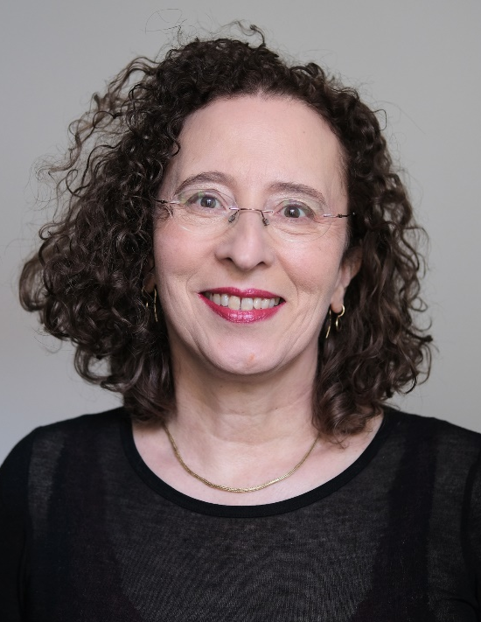
2024 Class A1 – Humanities Section – Philosophy, Theology & Religious Studies
Monika Betzler Munich Germany | Normative ethics Metanormative theory Moral psychology Ethics of personal relationships Philosophy of agency

Slide 74
2024 Class A1 – Humanities Section – Philosophy, Theology & Religious Studies
Robert Gordon Cambridge United Kingdom | Hebrew Bible/Old Testament Hebrew Bible in Jewish and Christian tradition Hebrew Bible and its ancient versions in Greek, Aramaic, Syriac, Latin Biblical Exegesis and theology Ancient Near Eastern context of the Hebrew Bible

Slide 75
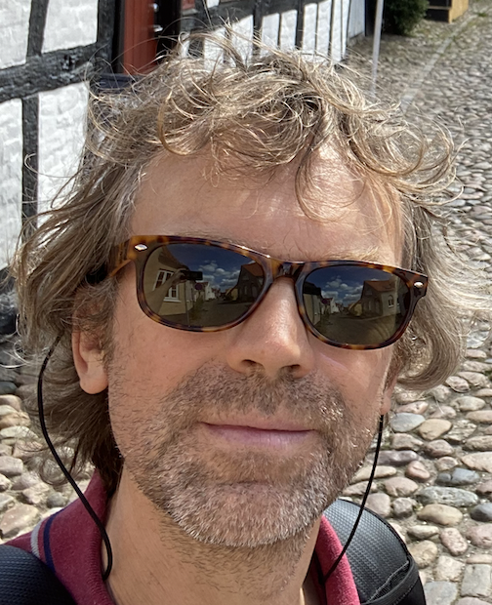
2024 Class A1 – Humanities Section – Philosophy, Theology & Religious Studies
Joost Joosten Barcelona Spain | Proof theory Formal logic Logic in AI and law Metamathematics

Slide 76
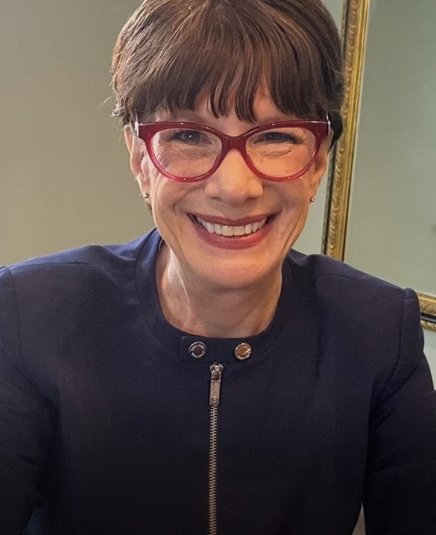
2024 Class A1 – Humanities Section – Philosophy, Theology & Religious Studies
Amy-Jill Levine Nashville USA | Christian origins Jewish-Christian relations Sexuality Second Temple Judaism Religion Gender

Slide 77
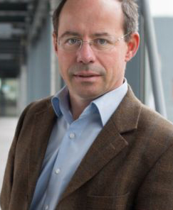
2024 Class A1 – Humanities Section – Philosophy, Theology & Religious Studies
Christoph Lüthy Nijmegen The Netherlands | History of matter theories History of philosophy, notably 1500-1800 History and logic of scientific imagery (diagrams, models, graphs, emblems, etc.) Theories of chance History of science, notably Scientific Revolution History of the philosophy of mind

Slide 78
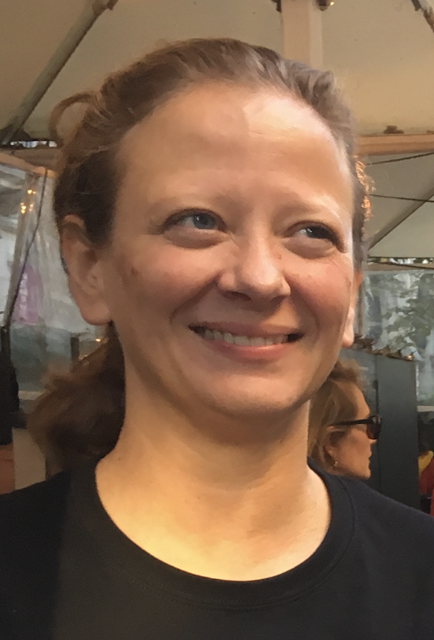
2024 Class A1 – Humanities Section – Philosophy, Theology & Religious Studies
Teresa Marques Barcelona Spain | Philosophy of language Conceptual engineering Epistemology Feminist and social philosophy Hate speech Metaethics

Slide 79
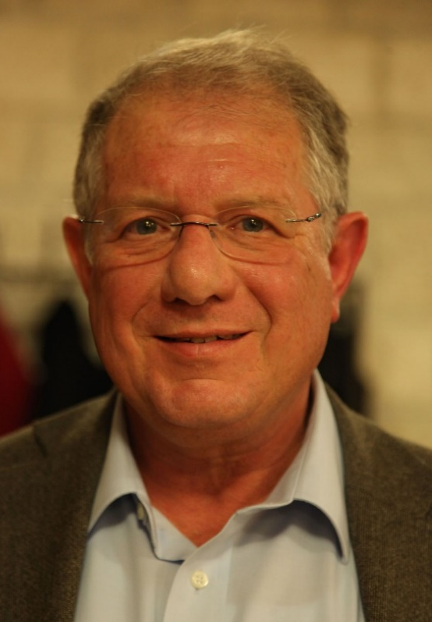
2024 Class A1 – Humanities Section – Philosophy, Theology & Religious Studies
Guy Stroumsa Jerusalem Israel | Comparative religion Religion in Late Antiquity History and historiography of the Study of Religion in Modern Times

Slide 80
2024 Class A1 – Humanities Section – Film, Media & Visual Studies
Overall section members: 116 Overall foreign members: 7 Overall female members: 54

Slide 81
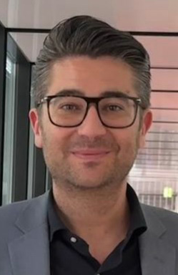
2024 Class A1 – Humanities Section – Film, Media & Visual Studies
Gabriele Balbi Lugano Switzerland | Political economy of communication Media history Science and technology studies Media archaeology Communication history

Slide 82

2024 Class A1 – Humanities Section – Film, Media & Visual Studies
Anne Kaun Stockholm Sweden | Automation and artificial intelligence from a humanistic social science perspective Algorithmic culture Media theory Mediated temporalities Political mobilization and social media

Slide 83

2024 Class A1 – Humanities Section – Film, Media & Visual Studies
Susanne Kinnebrock Augsburg Germany | Media change and transformations of the Public Sphere (since the 19th Century) Journalism (narrative journalism, convergent journalism) Gender media studies European communication history Health and science communication

Slide 84

2024 Class A1 – Humanities Section – Film, Media & Visual Studies
Margreth Lünenborg Berlin Germany | Affect studies Journalism studies Migration and media Gender media studies Public sphere theory Cultural studies and media research

Slide 85

2024 Class A1 – Humanities Section – Film, Media & visual Studies
Stefania Milan Amsterdam The Netherlands | Digital sociology Critical data studies Methodological innovation and computational social science Governance of and by digital technology Data and research ethics

Slide 86

2024 Class A1 – Humanities Section – Film, Media & Visual Studies
Irena Reifová Prague Czech Republic | Cultural studies Memory studies Post-socialist mediated memory Television studies and visual communication Media studies Qualitative methodology

Slide 87

2024 Class A1 – Humanities Section – Film, Media & Visual Studies
Ramón Salaverría Pamplona Spain | Journalism Digital journalism Disinformation

Slide 88
2024 Class A1 – Humanities Section – Film, Media & Visual Studies
Patti Valkenburg Amsterdam The Netherlands | Well-being Youth Social media Adolescents Media theory Media effects

Slide 89

2024 Class A1 – Humanities Section – Film, Media & Visual Studies
Barbie Zelizer Philadelphia USA | Memory studies Holocaust War and conflict Visual studies Journalism studies

