Slide 1
The 37th Annual Business Meeting of members of the Academia Europaea. Barcelona 15th October, 2025.
Draft agenda Ordinary Business 1. Welcome, adoption of the 2025 draft agenda (members present) 2. Minutes of the AGM held on 26 November, 2024 3. Reports (covering the past 12 months and going forward) • 3.1 2024 Trustees (Activity) report - President • 3.2 Finance – Professor Stephen Evans (Treasurer Other Business Elections and appointments 4.1 President (see agenda document for a summary) 4.2b Class Chair for Humanities | 5 SAPEA 3 6. Brief AE Regional Knowledge Hub Reports 2024/5 7. Report of the European Review – Professor Alban Kellerbauer 8. Patron member – HUN-REN report – Professor Balazs 9. Future Plans – President 10. Future annual conferences 11. Motion from a member – Professor Ferrini 12.Questions 13. Closing remarks

Slide 2
The 37th Annual Business Meeting of members of the Academia Europaea. Barcelona 2025. Document 3 – Outcome of the e-ballots
Agenda item 3.1– Motion number 1 Results for Resolution number 1: The Trustees ask the members to adopt the Trustees (activity 2024) report Eligible to vote 5863 Not voted 5453 I do adopt the trustees report of 2024 409 I do not adopt the trustees report of 2024 1

Slide 3
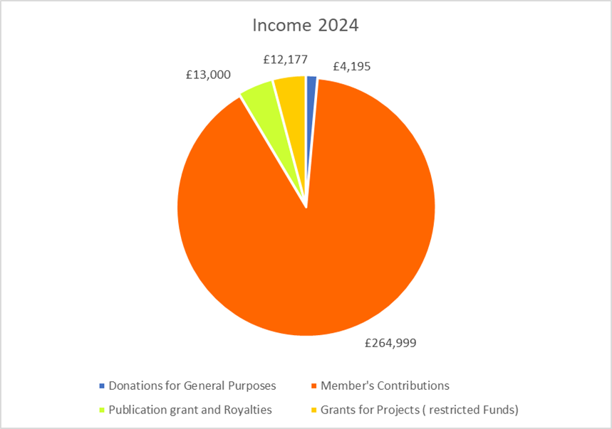
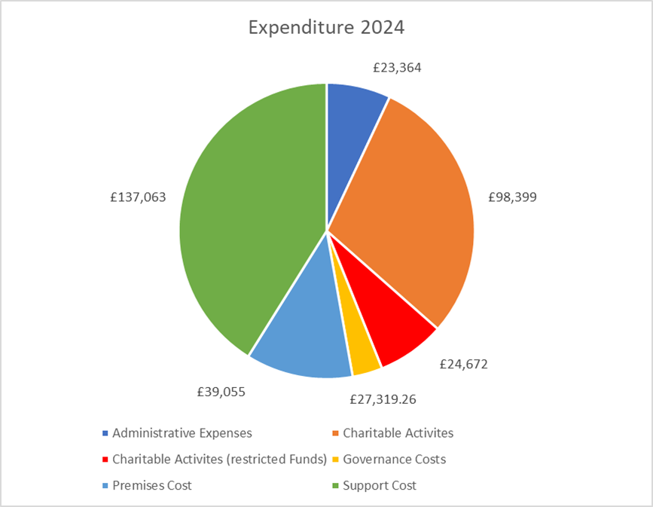
The 37th Annual Business Meeting of members of the Academia Europaea. Barcelona 2025. Agenda item 3.2 and 3.2 Suppl - Finance

Slide 4
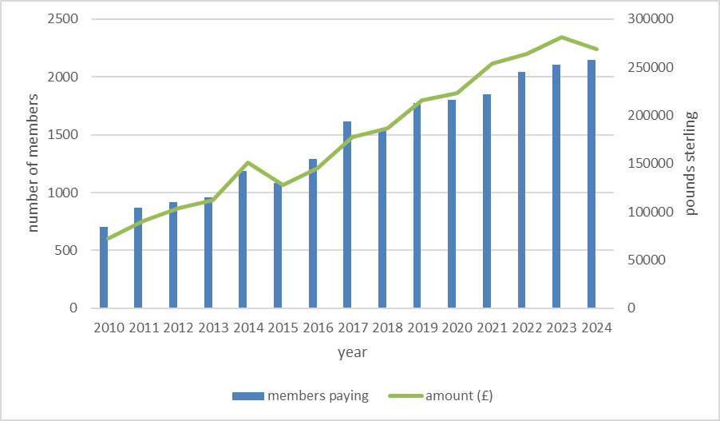
The 37th Annual Business Meeting of members of the Academia Europaea. Barcelona 2025. Agenda item 3.2 - Finance
Pattern of subscription income 2010 - 2024

Slide 5
The 37th Annual Business Meeting of members of the Academia Europaea. Barcelona 2025. Agenda item 3.2 – Finance – accounts e ballot
Agenda item 3.2 Motion number 2 Results for Resolution number 2: The trustees recommend that members adopt the examined accounts, for the year ended 31 December 2024. Eligible to vote 5863 Not voted 5456 I do adopt the accounts for 2024 406 I do not adopt the accounts for 2024 1

Slide 6
The 37th Annual Business Meeting of members of the Academia Europaea. Barcelona 2025. Agenda item 3.2.1 – Finance – auditors e-ballot
Agenda item 3.2.1 Motion number 3 Results for Resolution number 3: The Trustees ask members to re-appointment our accountants and examiners - Keith Vaudrey and Co Ltd. Chartered Certified Accountants, 51, Marloes Road, London W8 6LA , as auditors/examiners for 2026. Eligible to vote 5863 Not voted 5457 I do appoint Mssrs Keith Vaudrey Co Ltd as examiners 406 I do not appoint Mssrs Keith Vaudrey Co Ltd as examiners 0

Slide 7
The 37th Annual Business Meeting of members of the Academia Europaea. Barcelona 2025. Agenda item 3.2 – Finance – approval of 2025 member fees
Agenda item 3.2.2 Motion number 4 The Trustees recommend that members approve the following recommended scale of age-related membership fees from January 2026. The trustees are not proposing any increases for 2026. Members up to and including 65 years of age: 200 Euro [168 GBP] Members 66 - 75 years of age: 125 Euro [100 GBP] Foreign members (all age categories): 200 Euro [168 GBP] Results for Resolution number 4. The Trustees recommend that members approve the following recommended scale of age-related membership fees from January 2026. Eligible to vote 5863, Not voted 5461 I approve the recommended membership fee scale 370 I do not approve the recommended membership fee scale 32

Slide 8
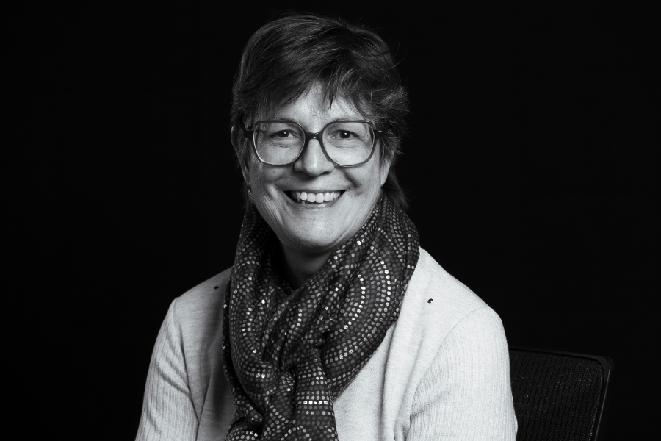
The 37th Annual Business Meeting of members of the Academia Europaea. Barcelona 2025. Agenda item 4.2 – Appointment of a new Class Chair – Humanities ( Class A1)
GENOVEVA MARTI– Former Section chair for Philosophy https://www.ae-info.org/ae/Member/Marti_Genoveva ICREA Research Professor, Departament de Filosofia, Universitat de Barcelona Fields of Scholarship Direct reference Experimental data and semantics Names and definite descriptions Carnap and quine on modality Semantics of general terms Modality Theory of reference

Slide 9
The 37th Annual Business Meeting of members of the Academia Europaea. Barcelona 2025. Announcements
NOMINATION OF CANDIDATES FOR MEMBERSHIP. Opened on 1st October – closes on 31st January 2025. See www.ae-info.org for full information. PLEASE READ THE GUIDELINES BEFORE NOMINATING A CALL FOR NOMINATIONS FOR THE AE ERASMUS MEDAL. The call will open before the end of 2025. All disciplines of CLASS A2– Social and Related Sciences. Co-ordinator Prof. Bjorn Wittrock. The Medal and lecture will be delivered at the Budapest Conference in October 2026. 2026 Annual Conference and AGM – Building Bridges – Budapest: 15th – 17th October 2027 Annual Conference and AGM – Bucharest Dates to be confirmed 2028 – 40th Anniversary of the foundation of the Academia Europaea - Venue and host – open to offers

